Slide 1
Ancient History Introduction Cities & Civilizations

Slide 2
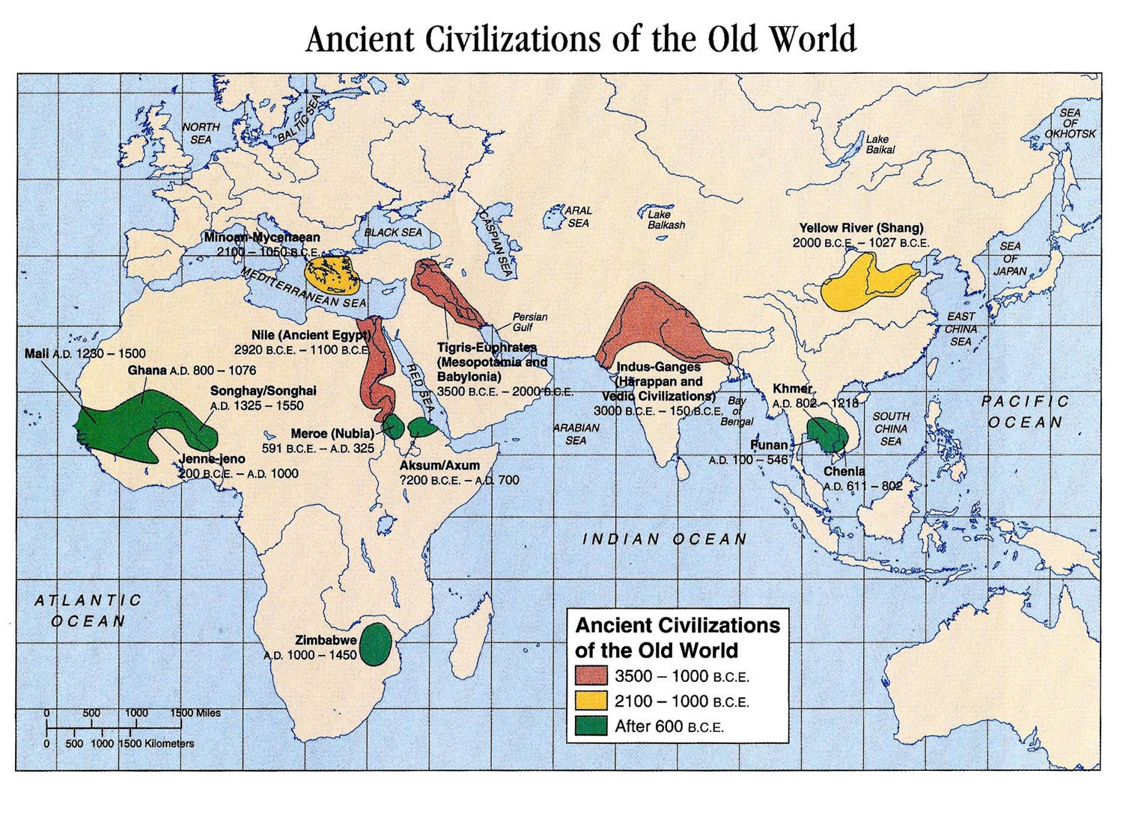

Slide 3
Mesopotamia

Slide 4
Ancient India

Slide 5
Ancient China

Slide 6
Ancient Egypt

Slide 7
Ancient Greece

Slide 8
Ancient Rome

Slide 9
Ancient America

Slide 10
Cities and Civilizations
Civilization is mostly an urban phenomenon
Civilization is nurtured in an urban environment
Famous people came from cities
Art, technology, writing, etc. came from cities

Slide 12
Dispersion of Humans

Slide 13
Life on Ancient Farms
80% of ancient civilizations lived on farms
Class would be boring if we focused on farms and farming technique
Born on small family farm
Likely to die in childhood
Barely grew enough food for survival
Lived a few decades if you survived childhood
Rarely left your land
Never travelled more than 20 miles

Slide 14
Life on Ancient Farms
Never saw a king or fought in a battle
Illiterate
Never saw a work of art
Never had cultural experiences
Equally accurate no matter where they lived on the planet
80% of all humans lived this way prior to the Industrial Revolution
25% to 33% of all babies died in the 1st year of life
Childhood disease claimed many others

Slide 15
Life on Ancient Farms
If a woman lived to puberty she had to give birth 5 times to keep population stable
Few people lived to old age
5% of men lived past 50 in the Roman Empire

Slide 16
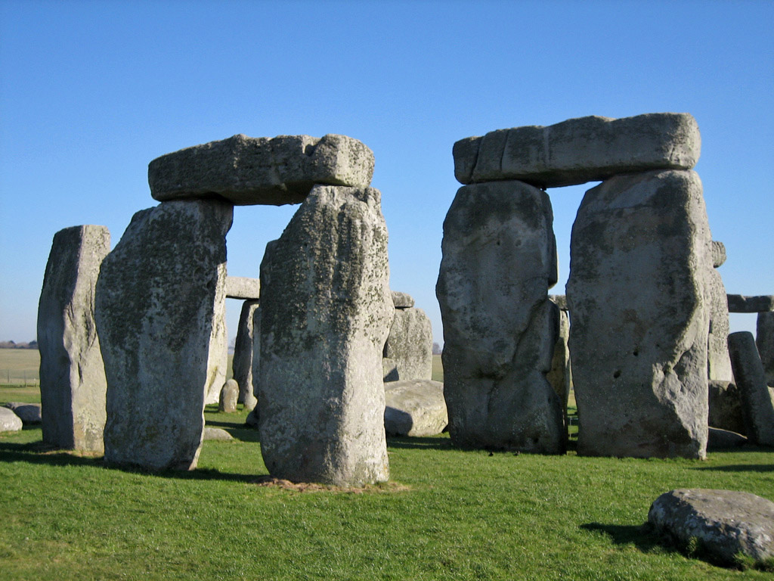
Studying Ancient Civilization
Scarcity of sources makes studying ancient history difficult
Very hard to interpret evidence from the ancient world
Example – stone towers in Africa – altars?

Slide 17
Studying Ancient Civilization

Slide 18
Studying Ancient Civilization
Ancient writers were very biased
Scholars disagree and debate actuality of events

Slide 19
Themes for this Class
1. Physical environment affects how culture evolves
2. When 2 civilizations collide or intermingle either peacefully or not – key changes occur
3. Innovations or experiences that occur across all civilizations
4. Contemporary culture today has basis in ancient history (how we live and interact)

